Slide 1
Showerhead Blade Model - CFD

Slide 2
Updated CFD Model
Hatches are modeled as a 1mm thick PLA shell around a "filler" material estimated to replicate the conductivity of 20% infill lattice with air pockets.
PLA Conductivity = 0.14 W/m*K
Filler Conductivity = 0.046 W/m*K (20% PLA, 80% Air)
The bulk of the blade is R-3315 Polyurethane
Polyurethane Conductivity = 0.044 W/m*K
Components are bound together by interfaces instead of periodicity to allow for adaptive mesh refinement (can cause discontinuities along boundaries)

Slide 3
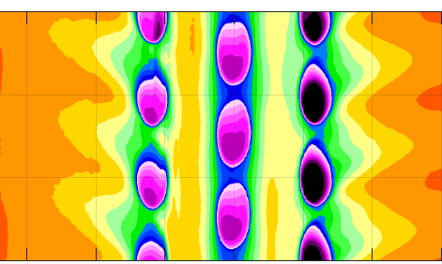
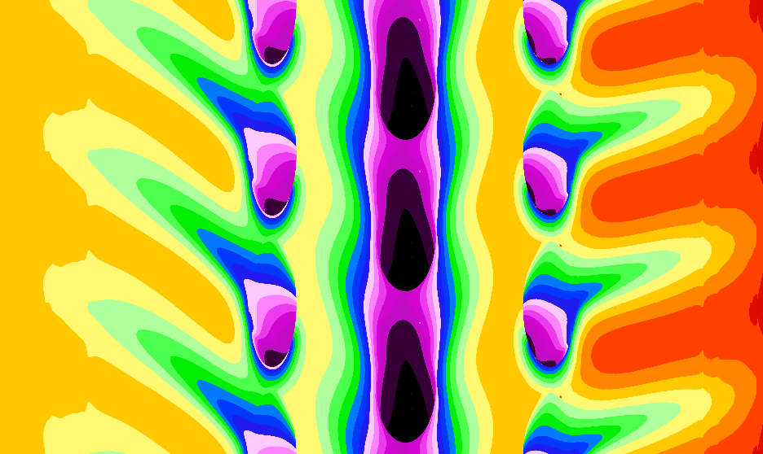

Eta Contours Similar Locations, about as expected
Experiment
The shape of the contours is similar but RANS always predicts jet mixing poorly so the jets stay coherent
Contour levels are at least within the ball park.
I've been investigating ways to improve the simulation by adjusting the infill conductivity but a bulk of the error is poor turbulent diffusion modeling in RANS
CFD

Slide 4
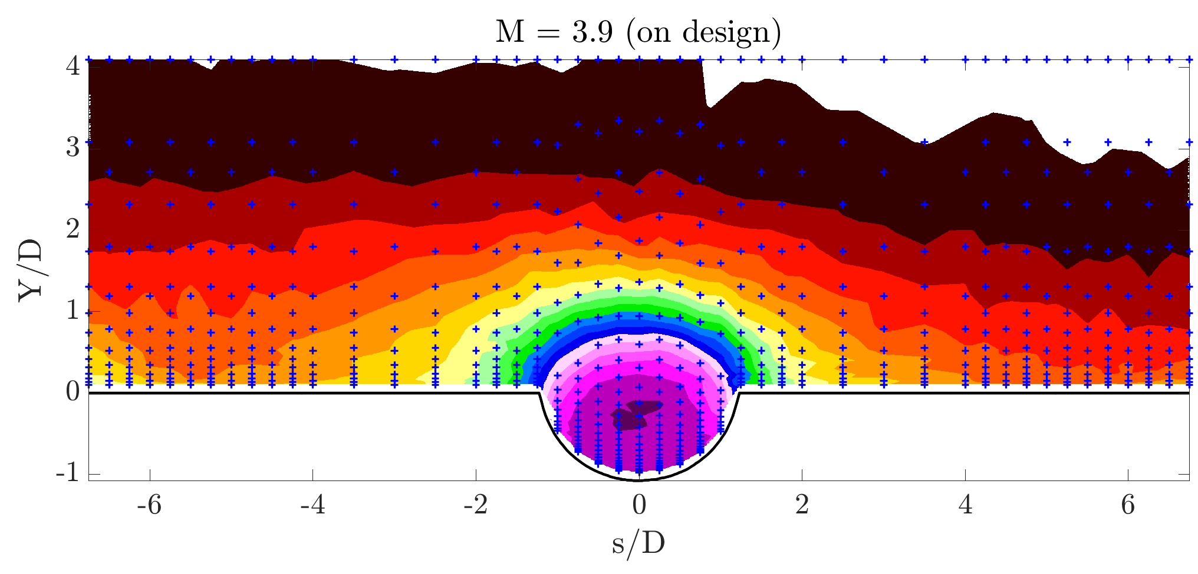
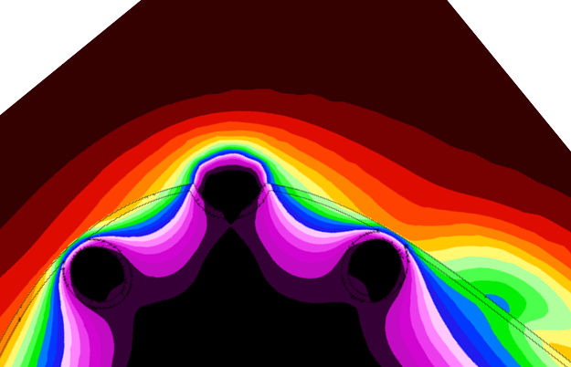
Comparison to Thermal fields
Similar to flat plate CFD we seem to do a good job of predicting the shape of the coolant exiting the hole.
Bear in mind that in my CFD the coolant is generated from the PVC pseudo-plenum and still behaving uniformly at the exit.
Soon we’ll be laying this data on the same grid for a better comparison

Slide 5
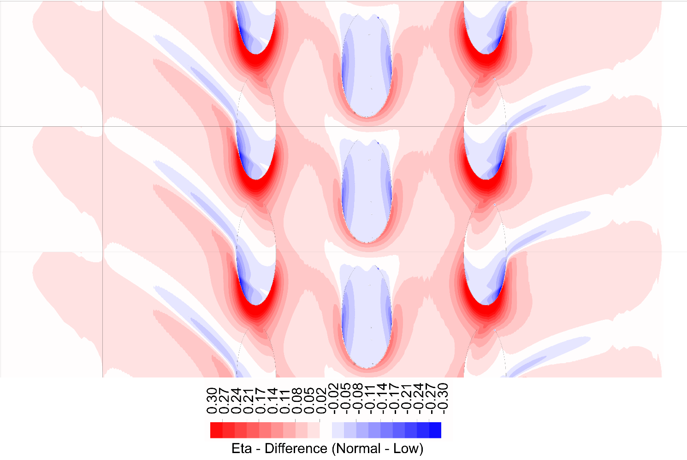
Estimation of the magnitude of the conduction correction for PLA & Filler
2~5%
Wall Normal Temperature Plot (On Next Slide)
+/-1.5%
<30%
The conduction correction remains small (2~8%) except on the side rows where there is no overflowing coolant to reduce the effects of bore cooling

Slide 6
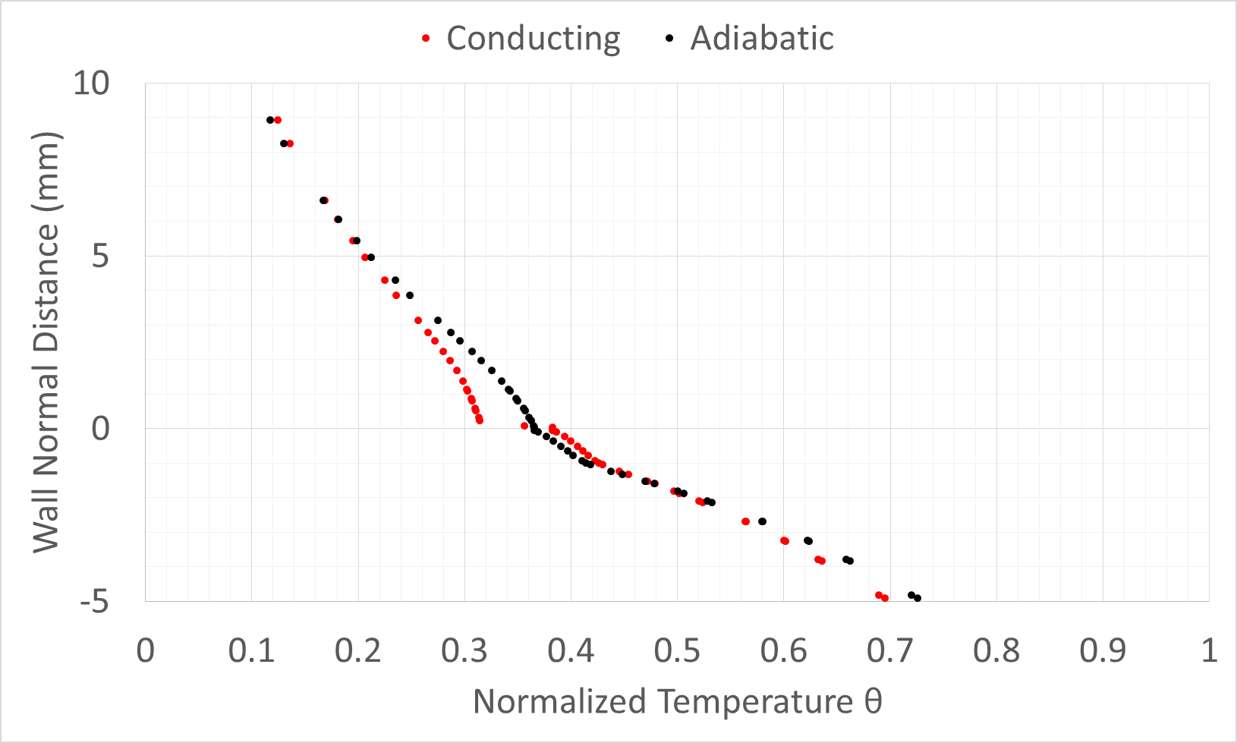
Wall Normal Temperature shows thermalfields alone are not sufficient to account for conduction
θ at 223 μm = 0.314
Conducting Wall θ = 0.383
Adiabatic Wall θ = 0.365
The large gradients of velocity and temperature in the viscous sublayer could cause significant differences between the thermalfield and IR measurements

Slide 7
Conclusions
The conduction correction is minimal for much of the blades surface and small for a bulk of the shower head (2~5%)
It seems unlikely that thermalfields would negate the need for a conduction correction, especially in areas of large bore cooling
The combination of CFD, IR, and Thermalfields is promising for delivering good insights into showerhead film cooling

